Slide 1
Loops. Error Handling, Strict mode
by Rostyslav Synenko

Slide 2
Loops in JavaScript Looping in programming languages is a feature which facilitates the execution of a set of instructions/functions repeatedly while some condition evaluates to true. For example, suppose we want to print “Hello World” 10 times. This can be done in two ways as shown below:

Slide 3
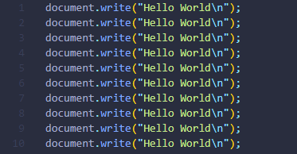
Iterative Method

Slide 4

Using Loops In Loop, the statement needs to be written only once and the loop will be executed 10 times as shown below:

Slide 5
Two Types of loops 1. Entry Controlled loops: 2. Exit Controlled loops:
Notes:
Entry Controlled loops: In this type of loops the test condition is tested before entering the loop body. For Loop and While Loop are entry controlled loops.
Exit Controlled Loops: In this type of loops the test condition is tested or evaluated at the end of loop body. Therefore, the loop body will execute at least once, irrespective of whether the test condition is true or false. do – while loop is exit controlled loop.

Slide 6
Different Kinds of Loops JavaScript supports different kinds of loops: for - loops through a block of code a number of times for/in - loops through the properties of an object for/of - loops through the values of an iterable object while - loops through a block of code while a specified condition is true do/while - also loops through a block of code while a specified condition is true

Slide 7

for loop The most frequently used loop in JavaScript is the for-loop. The for loop has the following syntax:
Notes:
A for statement consumes the initialization, condition and increment/decrement in one line thereby providing a shorter, easy to debug structure of looping.

Slide 8
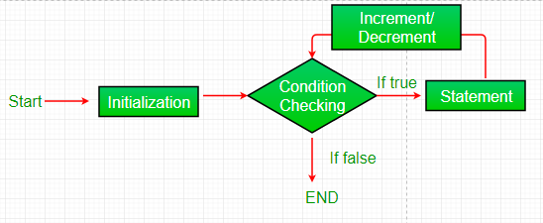
Flowchart:
Notes:
Initialization condition: Here, we initialize the variable in use. It marks the start of a for loop. An already declared variable can be used or a variable can be declared, local to loop only.
Testing Condition: It is used for testing the exit condition for a loop. It must return a boolean value. It is also an Entry Control Loop as the condition is checked prior to the execution of the loop statements.
Statement execution: Once the condition is evaluated to true, the statements in the loop body are executed.
Increment/ Decrement: It is used for updating the variable for next iteration.
Loop termination:When the condition becomes false, the loop terminates marking the end of its life cycle.

Slide 9
Error Handling

Slide 10
Strict mode

Slide 11
Links 1. 2. 3.

